Slide 1

Find It!
Painless Shopping
An app by Moe and Sam
Notes:
Hey guys, I’m Moe and this is Sam. The project that we’ve taken on this semester was given the name Find It! Painless Shopping. It’s an app that allows users to strategically plan out their visits to the centrum shopping centre as well as browse for items in an efficient and compact way. Now, the app’s name is pretty straightforward, so you probably figured most of that out before I even finished my long-winded sentence. But this was one of 3 preliminary ideas that we came up with during our brainstorming stage.
Before settling on this idea, we had to eliminate the possibility of a music theory app as well as an Earl student services app. This would’ve allowed students to purchase tickets to events, buy student clothing, pay student fees, and handle everything else that would’ve required a transaction between Earl of March and the student. These being 3 great and actionable ideas, we knew that in any direction we chose to go there was the potential to make something that we would both be proud of, and that was really important to us. As you will see during our product demonstration, this drove us to really make the app the best that it could be. Now without further ado, let’s talk about our client Sophie.

Slide 2

Meet Sophie
Grade 11 Earl Student
Regular Shopper
Would like an app to help facilitate her shopping experience
Requirements
Android Compatible App
Must work for Centrum Area
Must analyze: store, price, brand
Notes:
Sophie is a student here at Earl, much like yourselves. Sophie’s into Art, Books and Fashion. She enjoys shopping but often finds herself wasting time going from store to store searching for the item that she wants. On average, she’ll visit the centrum shopping centre twice a week, which, over time, adds up.
Knowing Sophie personally, she was the first person that came to mind when thinking of a client. Her requirements for the app were: android compatibility, working for centrum, and analyzing all of the basic details of queried items. These were all solid criteria and we were very lucky to have been given clear responsibilities by our client. With these needs in mind we created a comprehensive list of the core functionalities of the app.

Slide 3
Our Projected End Goal
To make an app that:
Was easy to use
Searched multiple stores at once
Flowed Visually
Stored information about large amounts of items
Created and sended (via email or IM)a list of items that included store, price, and title
Did all of this without lagging
Notes:
We set out to create an app that was both thoughtful and intuitive. It had to ;search multiple stores at once, have a strong sense of visual flow, have the capability to store large amounts of data, and create and send (be it via email or instant message) a list of items that included their store, price and title. And It had to do all of this while maintaining a respectable overall speed.
We had a very clear idea early on about what had to happen and when it had to happen in order to make this app a success. We look forward to showing you the end product

Slide 4


User Demographic Targets
Local Residents ranging in age group from young children to mature adults
Notes:
Determining the target audience for a product allows developers to estimate profit margins and better design their app to fit into the daily lives of their target audience.
In our case, this proved to be a little tricky. The key reason for this is that our app was a utility, so we had to evaluate who would realistically be able to use our app on a daily basis. Because this is predominantly a planning app, it was decided that anyone fitting into the age ranges of young child to mature adult would be able to navigate and use our app. It could range in use from a child planning out his back to school shopping to help his parents budget to a busy adult planning in advance to adhere to an intense schedule.
That coupled with our apps simple and intuitive design makes it suitable for generally all ages.
Now knowing what we needed to do and who we were doing it for, let’s take a look at the resources that made this all possible.

Slide 5






Software Platforms & APIs

Slide 6
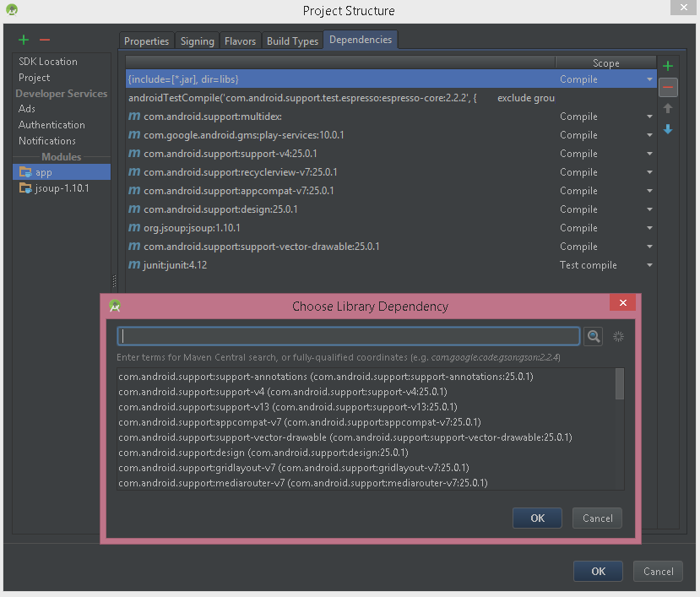
Managing Project Library Dependencies
APK Signing

Slide 7

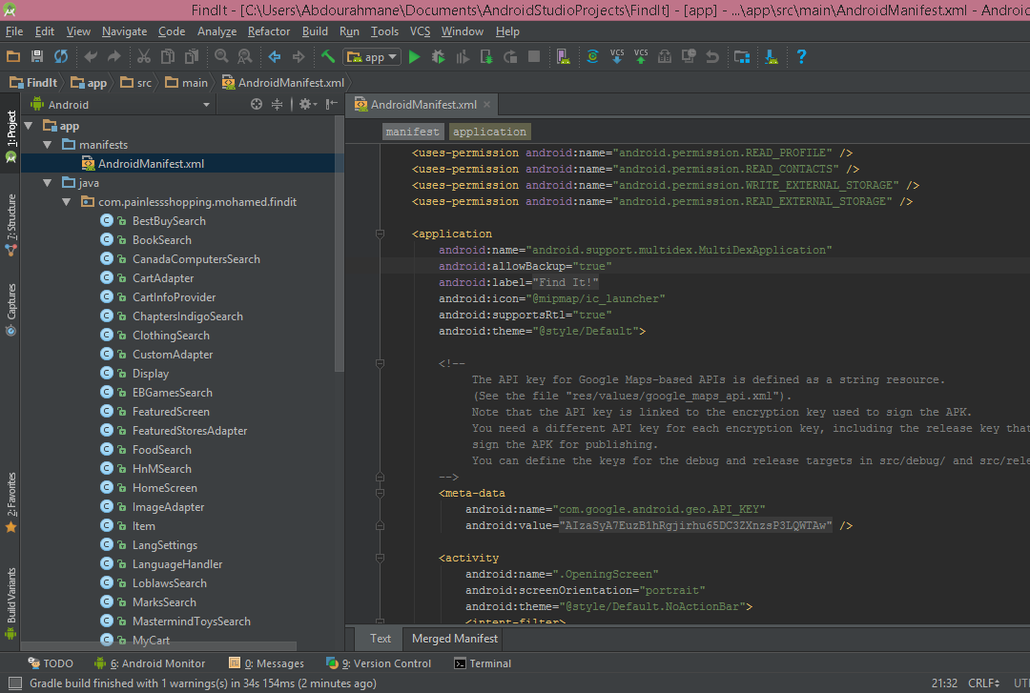
Android Studio
IDE
Runtime Environment
Version Control
Notes:
If we were to rank these software platforms in terms of importance, Android Studio would be paramount to the others because this was the core program used to build our app.
It is an IDE or integrated development environment that makes use of a lightweight, sleek UI to streamline the development experience. To top it off, it also has Git built in, which made updating and maintaining the app easier than any developer could wish for.
We used Android Studio to code, test, and design our user interface as well as maintain and update our code using the built in git client.

Slide 8




Android SDK
Required Libraries
Debugger
An emulator
Android API Documentation
Notes:
This software platform sort of ties into the previous one. The Android Software Development Kit provided us with all of the tools necessary for working with Android devices in all of their versions. The difference between Android Studio and Android SDK lies in that Android Studio is an IDE, meaning we do our coding on it, whereas Android SDK contains a library that allows Android Studio to read and interpret our code.

Slide 9
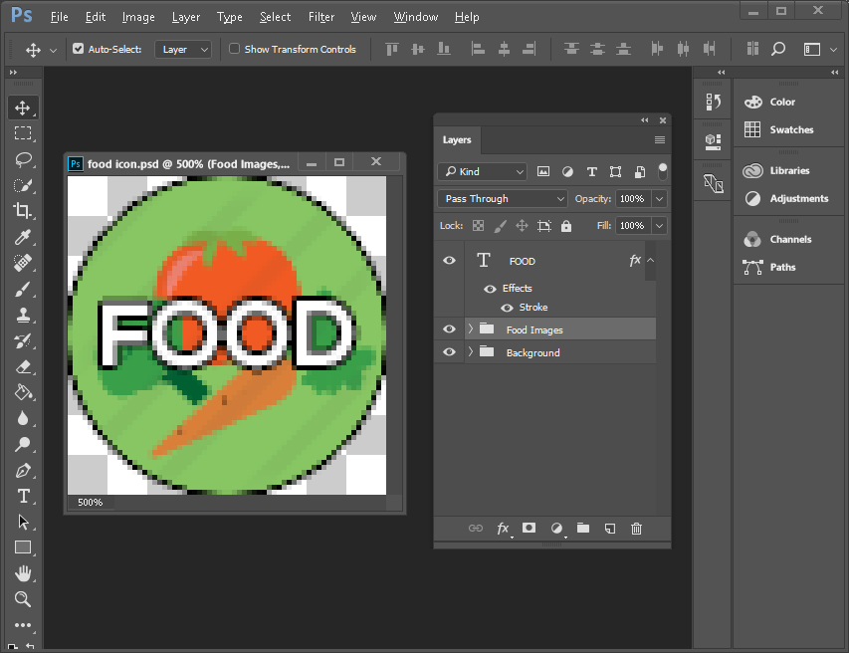
Adobe Photoshop CC 2017
Category Design
Image Editing
Notes:
For the majority of the visuals featured in the app, photoshop was used.
It is a part of the Adobe Creative Suite and is used primarily for image editing although it can be used for digital art as well as logo design. Along with Adobe Illustrator, Photoshop was my goto whenever we needed visuals done. The search icons were done in photoshop and the app logo was retouched in photoshop.

Slide 10
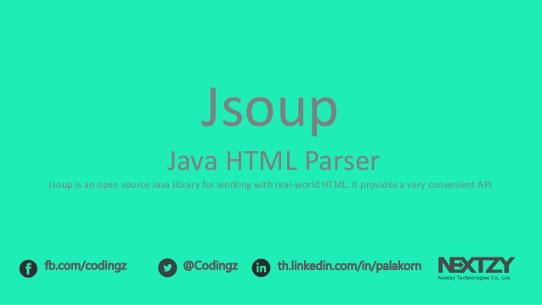
JSoup
Java-Based
HTML Parser
Scraping Websites
Running Background Tasks
Notes:
Jsoup is a Java Library that allows users to read and manipulate the HTML content of web pages. This allowed us to gather information from web searches of specific websites. No 2 websites were the same however, so we had to create a unique method of searching the site for each of them. Jsoup is great because it’s very version friendly. It doesn’t require a lot of resources and can run on very low Android versions.

Slide 11
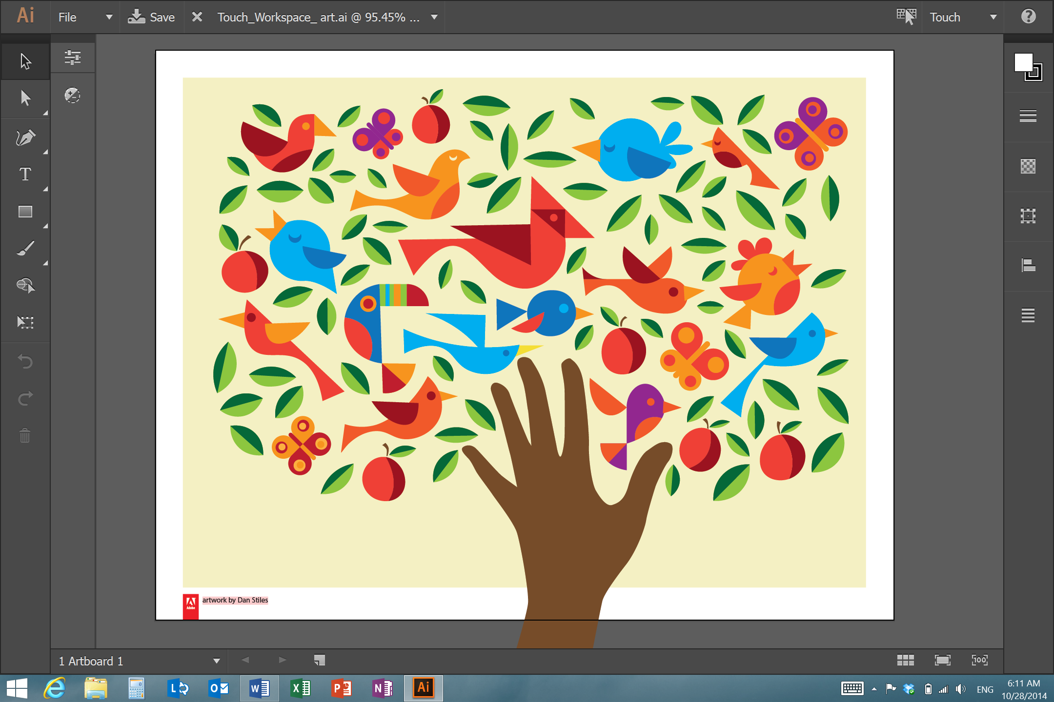
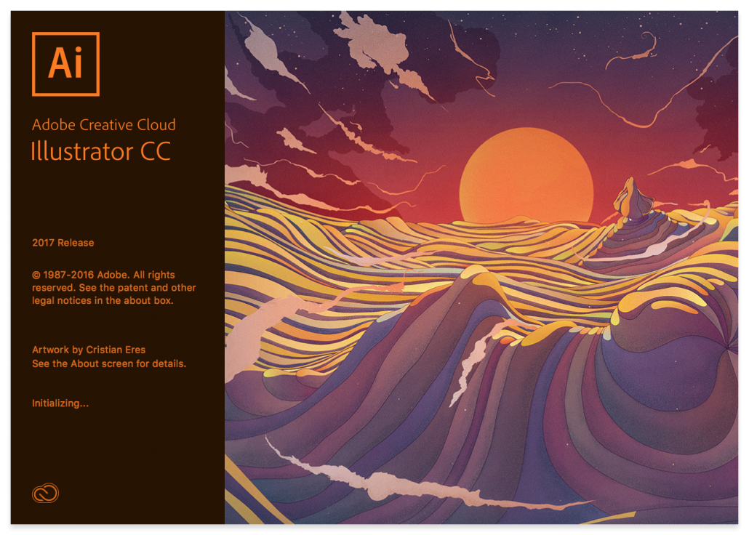
Adobe Illustrator CC 2017
Logo Creation
Notes:
Adobe Illustrator is another piece of software on the Adobe Creative Suite and follows the same customizable workflow style as photoshop.
Illustrator revolves around vectors and works with svg’s or scalable vector graphics. The benefit to this is that designs created in illustrator can be scaled to very large degrees and retain 100% of their quality. However the downside to this is that because it relies on shapes and paths to produce its images, it is difficult to make particularly intricate designs. Because of this, Illustrator’s most effective use lies in logos and simple designs. Which is exactly what we used it for. Our app logo is the one that’s been appearing in the top-right corner of the screen.
Now to anyone wishing to work with either Illustrator or Photoshop in the future, it is important to note that most graphic designers use both in conjunction with each other. You’ll have the people who swear by illustrator and the ones that swear by photoshop, and there’s nothing wrong with that per say, but each of them have their own uses and well-rounded design tends to come from a combination of the two.

Slide 12

Product Demonstration!
powered by Vysor
Notes:
Show Featured Stores, Set Language, Showcase two themes, then close app and demonstrate File IO.
Go back into app and search for MacBook, showcase sort functionality, info button, add 5 items to cart, showcase undo.
Go to cart and showcase remove from cart and undo.
Finally, showcase send cart by emailing Sam at sam.jonesrus@gmail.com

Slide 13
Challenges That We Faced
Personal
Working in unfamiliar environments and coding languages (Being Android Studio coupled with XML)
Time management
Not being able to fit in all that we would’ve liked to for the app (however still satisfying all of the required functionalities)
Code Related
Scraping Lazy-Loaded Webpages
Parsing JavaScript Generated HTML
Notes:
Now, no project will every go according to plan. That’s just a fact. Along the way it will always have its trials and tribulations but with discipline and planning ahead, you can overcome these hurdles. There were two main hurdles, if you will, that we had to get over throughout the development process. These were working with completely new environments as well as preset time constraints as a result of this new environment.

Slide 14
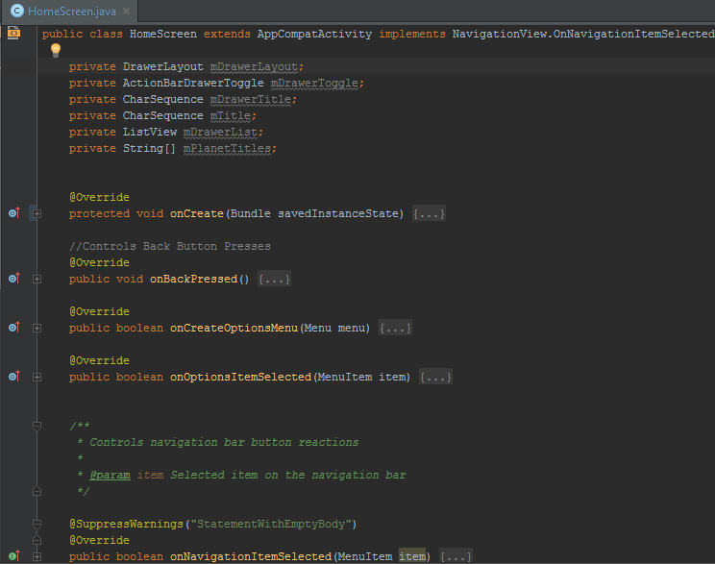
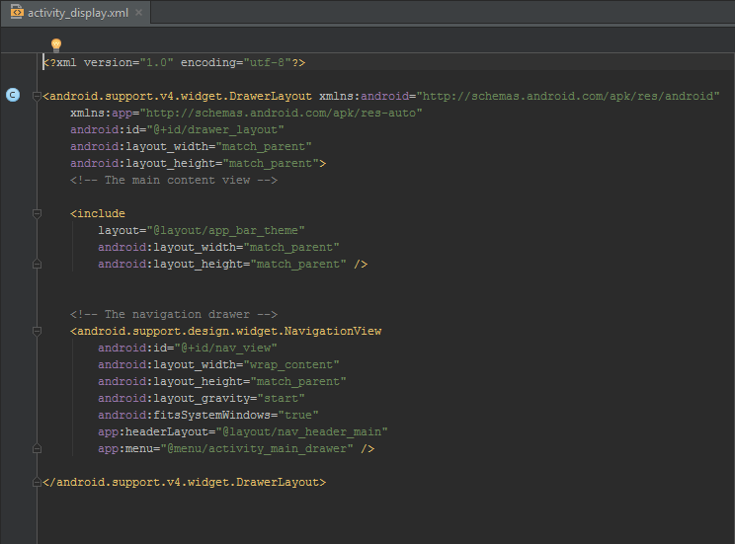
Android Studio (Challenges cont’d.)
Notes:
Android is very particular about the way you do things. There is a method for everything and if you try to brute force it or do it your own way, you will end up completely crashing your program. Because of this, at each stage of otherwise relatively basic coding, we had to find out how Android wanted us to do it. In that regard, Android was sort of like a new language from Java altogether.
To give you an example, look at this screen here on the left. You’ll see that almost every method written says @Override. That alone should tell you that Android is very strict in the way they do things because they essentially require you to follow a template. The screen here on the right is the XML layout resource file for our theme selection screen.
The transition to working with XML was relatively streamlined because Android Studio provides a real time visual representation of all XML created. This made it easy to see what our code was doing while writing it.

Slide 15
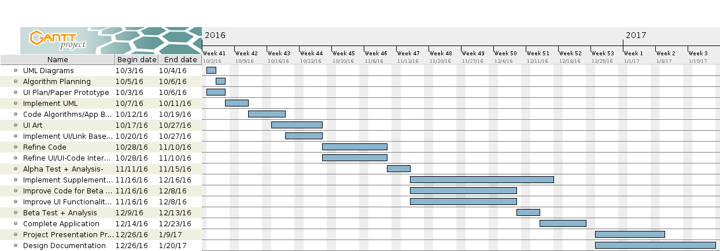
Time Management (Challenges cont’d.)
The gauged difficulty of certain tasks were not entirely accurate.
Notes:
Making the Gantt Chart was a helpful exercise and helped us stay on track with the project. However because we were working in a completely new environment, some of the otherwise reasonable deadlines became less reasonable. For example, we thought we’d be able to make all of the UML diagrams in two days. Not realizing that we’d have to heavily modify our original design to conform to android’s very specific project structure, two days turned into four, which admittedly turned into five. Luckily though this was all planned for in our very thorough risk analysis section of our Project Plan.

Slide 16
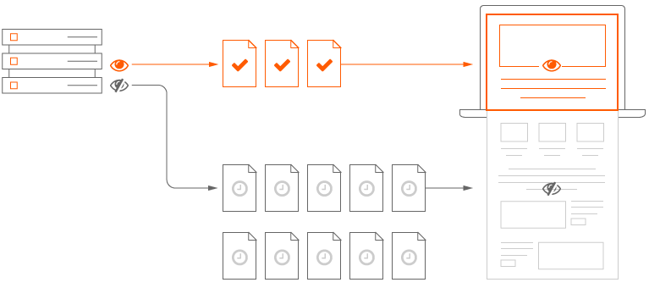
Scraping Lazy Loaded Webpages (Challenges con’t)
A diagram illustrating the concept of lazy-loading.

Slide 17
Solutions
Use an external Web Driver to effectively “scroll to the bottom of a webpage” and then return page source
2. Generate AJAX requests using Firebug extension and parse raw JSON.
Rejected because:
Increased app build time by over 400%
(from 3 minutes 37 seconds to 13 minutes and 48 seconds)
Search completion took noticeably longer relative to Solution #2
Naive and inefficient approach
Accepted because:
No noticeable affect on app build time
Uses internal Android libraries to parse input
(No speed loss due to ‘middle-man’ external library)
Far more effective data-processing algorithm

Slide 18
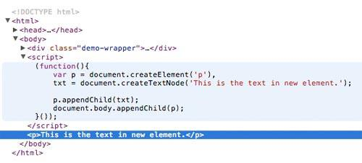
Parsing JS Generated HTML (Challenges con’t)
Solution:
Render Web Page using an invisible Android WebView
An example of code used for generating HTML with JavaScript.

Slide 19

Client Fulfillment
Overall, our client was very satisfied with our app and plans to use it whenever she is planning a trip to centrum.
Some of the factors that contributed to the success of this project were:
Good client communication
Flexible SDLC
“Nice! It looks great to me.”
-Sophie Joslin
Notes:
However in the end, it was all worth it because our client was very happy with our app. Some of the factors that contributed to the success of this project were good client communication; which admittedly wasn’t hard because we have 2 classes together, and a flexible SDLC. Good client communication is critical because recognizing that the client’s needs may change slightly along the process and planning for that allows for the highest degree of client satisfaction. Incorporating a flexible SDLC is also very important because it allows for adjusting code to meet your client’s dynamic needs.

Slide 20

REFLECTION
APP JAM 2017
Group Satisfaction
Notes:
In terms of team satisfaction we are both satisfied and proud of our app. We plan on using the app regularly and continuing its development for AppJam this year.

Slide 21

Reflection
Android Development
Android Development Kit
XML
Planning
Rendering event-dependent code
The importance of scalable vector graphics (SVGs) to mobile design
What We Learned
Notes:
To sum up what we learned during this project; we have become proficient with XML and the Android Development Kit, have gotten a strong grasp of how to plan for software projects, and finally, the importance of scalable graphic design. The last point especially so, because the icon that looks great on your phone may look tiny and illegible on someone’s tablet.

Slide 22

Reflection
The size of image required for Android Screens
File IO on Android is Completely Different
The simplest bugs being the most problematic
Biggest Surprises
Notes:
There were really on 3 big surprises that we encountered during our app development. They were all pleasant surprises, so no added anxiety there. The first was that, git was actually very simple. After looking on the website there’s all of these options and all of these git clients which can seem daunting at first, but when you start working with git it becomes second nature. The second pleasant surprise was that Android Studio came with a library of readily available, multi-purpose, vector icons. This saved a lot of time in the way of fishing for icons to make the UI visually pleasant. The third and last pleasant surprise was that, two people could actually work on the same file at once. I initially thought that this would cause problems but to my surprise, it worked beautifully.

Slide 23
Pointers for Future Developers
Familiarize yourself with Java & Android formatting
It’s not so much a matter of being able to recite every function but rather having a general understanding of how Android works
Plan Ahead
Don’t hardcode ANYTHING
Make a realistic plan and be strict with your deadlines
Make sure you recognize your projected functionalities
Understand the basics of how to implement them
Ex. multiple languages (string.xml)
Recognize that ambition must be backed by hard work
Notes:
If we were to give future developers advice on how to create a similar project, first and foremost it would be to familiarize yourself with java and android formatting. It’s not so much a matter of being able to recite every function but rather having a general understanding of how Android works so that when you start development you don’t waste too much time. The next piece of advice is to use references for everything. It will allow you to easily change references in your code and keep track of resources. The final piece of advice would be to make sure that before you start you recognize your projected functionalities and how they’ll interact with each other. In example, in order to translate the app, you’ll have to make string resources and reference them in all of your UI classes. You will then have to create translations and a way to set the languages for the entire app. Having a rough understanding of how this works will speed up the development process indefinitely.

Slide 24
Want to download our app?!
On your ANDROID phone go to : https://github.com/FindItPS/Find-It-Android/releases/tag/v1.0.1
Click the three dots in the corner and from the menu select “Request Desktop Site”
Click the link “app-release.apk” and once it has downloaded open the app from your notifications
It’s not a virus we promise (hehe)
Notes:
If you’d like to try the app yourself you can follow the on-screen instruction to download and install the app if you have an Android phone. First go to the link on the screen and click the three dots in the corner. From the drop down menu select “Request Desktop Site” and click on the link “app-release.apk” and once it has downloaded open the app from your notification pop up.

Slide 25
Thanks for Listening!
Notes:
We hope that you enjoy the app and the concludes our presentation. We’ll now be taking questions

